Slide 1

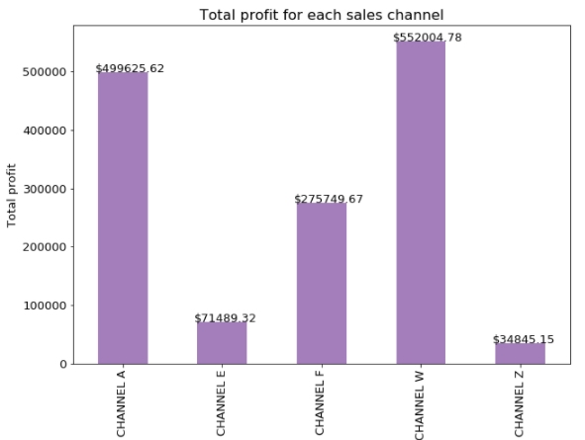
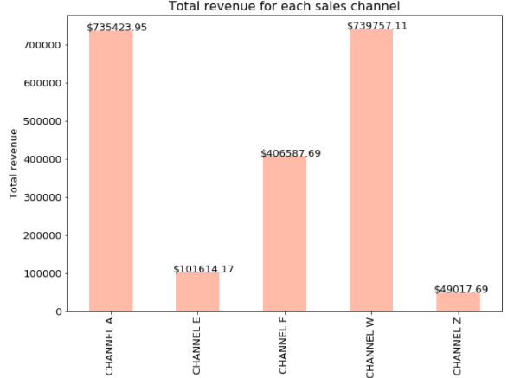
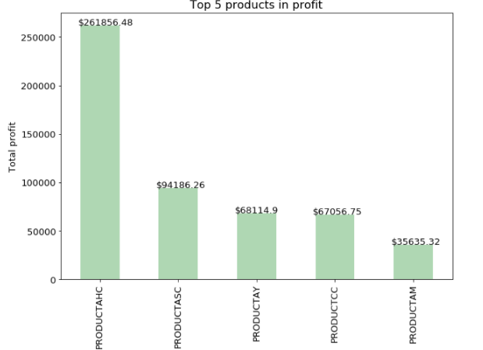


What are sales and profitability by channel? What is the best item we sell?
$profit=Extended Price −Default Cost ×Quantity$
Channel W and A have higher profits than other channels
$revenue=Extended Price$
Channel W and A have higher revenues than the other channels
Product AHC has the highest profit and the highest sales number

Slide 2

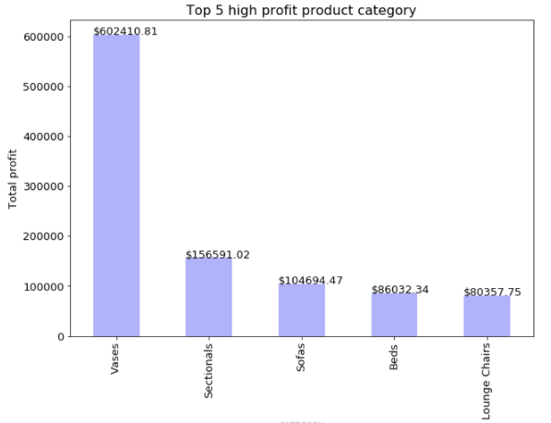



Which product category has highest profitability?
Vases bring much more profit to the company compared with other product category

Slide 3
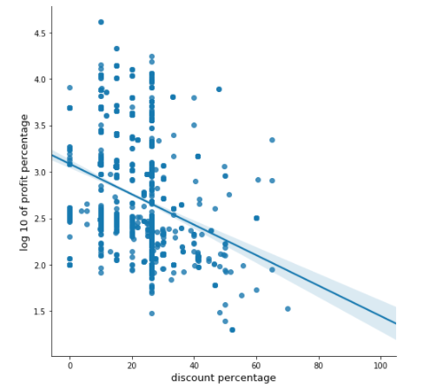

What is the relationship between discount and profit?
In order to answer this question, two variable were created
$profit_pct_log10=log10(\left(\frac{Extented Price −Default Cost ×Quantity}{Default Cost ×Quantity}\right)×100)$
$discount=\left(\frac{Unit price before discount −Unit price after discount}{Unit price before discount}\right)×100$
There is a negative relationship between discount and common logarithm of profit percentage. In other words, the more discount, the less profit

Slide 4
Does the effect of discount different on various price Ranges ?
Products are split into 5 groups based on their “Unit after discount price”. Linear regression is performed to compute the discount sensitivity.
Low - price is below $166
2_cluster – price is between $166 and $192
Median – price is between $193 and $230
4_cluster – price is between $231 and $518
High – price is larger than $518
Discount sensitivity is a number used to measure the strength of relationship between discount and profit percentage
Discount sensitivity = absolute slope of the regression between discount and profit percentage

Slide 5
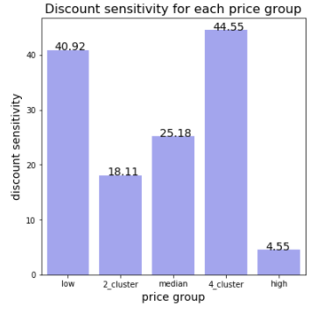
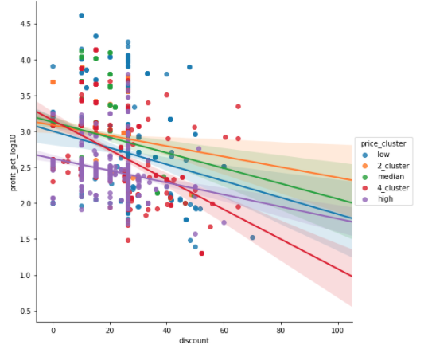
Products belong to “low” group or “4_cluster” group are very sensitivity to discount. Decrease the discount of these products to get more profit
Products belong to “high” group are not sensitivity to discount. So increase the discount of these products to attract more customers

